Slide 1
Spring Framework

Slide 2
Spring Framework Training Contents
What is Framework? Purpose of commonly used Java Frameworks. Brief on Spring Framework Architecture.
Spring Framework 4.x and What is Dependency Injection, thru Constructor, Setter? What is Spring Bean? How Spring promotes Loose Coupling. AutoWiring
Aspect Oriented Programming and Advantages. Cross Cutting Concerns(like Logging, Transactions,etc…) AOP Terminology(Join Point, Aspect, Advice, and different types of Advices)
What is PointCut Expression Pattern, and how it dynamically weaves Join Point and Aspect
Basics of Proxy Pattern and Java Reflection

Slide 3
Spring Framework Training Contents(Contd…)
Explaining how Advice is not directly invoked from Join Point
How to include Spring jar files in Build path, XML and Annotation.
Examples with multiple same types of Advices within Single Aspect
How to use multiple Aspects within a Project
Concluding with how Spring supports JDBC, Hibernate Templates and JAXB.
Difference between spring 3.x and 4.x
Spring Web services, SOAP(more focus), REST
Spring Security

Slide 4
Training Prerequisites
Working Knowledge in Core Java
Knowledge in
HTML, CSS, JavaScript
JSP, Servlets(Filters)
Knowledge in other Java Frameworks, like Hibernate
Knowledge in Design Patterns

Slide 5
What is a Framework?
Frameworks are large bodies (usually many classes) of prewritten code to which you add your own code to solve a problem in a specific domain.
Generally, a framework controls flow of execution and invokes the source code provided by developers.
Developers make use of a framework by calling its methods, by inheriting, or supplying "callbacks“.
Generally Framework is provided as jar file(s)
Popular Java Frameworks are
Hibernate – ORM Framework or Object persistence Framework
Spring – General purpose Framework
Struts – MVC Framework

Slide 6
How Framework is used by Application?
Framework(For Eg. Spring)
Application
Java
Above Diagram shows how Application uses any Framework such as Spring

Slide 7
Why should I use a Framework?
Though Developers need to invest sometime in learning and getting expertise on Frameworks, below are advantages of using Framework(s)
Application development is faster, hence faster Time to market.
Since Application source code will be relatively smaller, maintenance will be easier.
You develop only required Business logic, and all required routine code may be provided by Framework(s).
Your application is inline with Industry standards.
Spring is a General Purpose Framework or Framework of Frameworks.

Slide 8
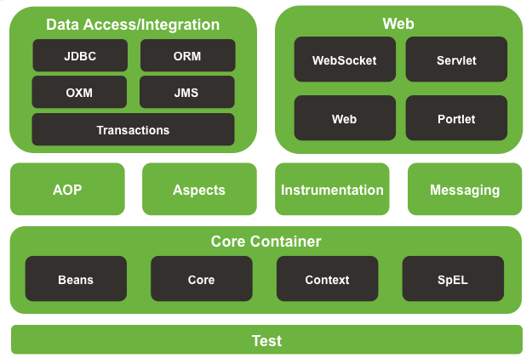
Spring Architecture
Spring Framework official Website:
https://spring.io/

Slide 9
Spring Framework Features
DI/Inversion of control container : Configuration of application components and lifecycle management of java objects, which promotes loose coupling. Aspect-oriented programming : Enables implementation of cross-cutting routines, which drastically reduces duplication of code. Data access : Working with relational database management systems on the java platform using JDBC and object-relational mapping tools, minimizes the source code to interact with Databases. Transaction management : Unifies several transaction management APIs and coordinates transactions for Java objects, provides annotation based Transaction handling(instead of using commit/rollback calls manually).

Slide 10
Spring Framework Features
Model-View-Controller : An HTTP and Servlet-based framework providing hooks for extension and customization, to expose web based REST Apis.

Slide 11
Spring Framework Components…
Batch processing : A framework for high-volume processing featuring reusable functions including logging/tracing, transaction management, job processing statistics, job restart, skip, and resource management. Eg. Generation of Pay Slips. Automatic periodic execution of a program Spring Security: Configurable security processes that support a range of standards, protocols, tools and practices via the Spring Security sub-project (formerly Acegi). username, password, encryption, role management Actuator/Remote Management : Configurative exposure and management of java objects for local or remote configuration via JMX, to cross check if server is working fine or any problem. Messaging : Configurative registration of message listener objects for transparent message consumption from message queues via JMS, improvement of message sending over standard JMS APIs, to interact with Messaging Systems such as Kafka, RabbitMQ.
Testing : Support classes for writing unit tests and integration tests.

Slide 12


Which Laptop Table do you prefer?
Table B
Table A
Depending on an interface
Depending on Concrete class

Slide 13
What is Dependency Injection?
Dependency injection is a framework that takes care of creating objects for us without having to worry about providing the right ingredients or parameters.
For example, if below class can be used to send an email.
public class Email
{
public void sendEmail(String subject, String message)
{
// Send the email code
}
}
So, from where ever you want to send an email, you can create an object of Email class, and invoke sendEmail() method. There may be hundred or even more places from where you may do it, from your App.

Slide 14
public class Person
{
private Email email = new Email();
public void greetFriend()
{
email.sendEmail("Hello", "Hello my friend ");
}
}
We write above code, when we want to send an email from Person class.
We all agree that this is a very simple and straightforward example that involves two simple Java classes. Nevertheless, the above has some limitations as described below.

Slide 15
Disadvantages of this Approach are…
The Person class is dependent (has a strong/tight dependency) on the Email class. There is a hard connection between these two classes. Let say we have a new and better version of email class, FastEmail, in order for us to use it, we need to go in each and every class that depends on the Email class, such as the Person class, and replace it with the new version.
Let say we parameterise the Email‘s constructor. Again we have to go in each and every class that is initialising the Email class, such as the Person class, and change it.
A design decision is taken to make the Email class Singleton. Similar to above we need to modify all instances where it is used.

Slide 16
Better Design
The Email class provides a service, that is, sending of messages over the Internet using the mail protocol. Instead of having the Person class initialising an instance of the Email class, we first create an interface, MessageService, and make the Person class using this interface instead. This removes the tight dependency that the Person class has on the Email and replaces it with an abstract message delivery interface.
Define interface
public interface MessageService
{
void sendMessage(String subject, String message);
}
Implement interfaces
public class EmailService implements MessageService
{
Email eobj = new Email();
public void sendMessage(String subject, String message)
{
eobj.sendEMail(subject, message);
System.out.printf("Email: %s, %s%n", subject, message);
}
}

Slide 17
public class FastEmailService implements MessageService
{
public void sendMessage(String subject, String message)
{
System.out.printf("Fast Email: %s, %s%n", subject, message);
}
}
Use Interfaces
Finally, instead of using classes, we use interfaces. In the Person class, we replace the Email field with the MessageService service interface.
public class Person
{
private MessageService messageService;
//Note, instead of directly creating object in below constructor, we let the invoker of this constructor, //to create object of either EmailService or FastEmailService, and send as parameter.
public Person(MessageService messageService)
{
this.messageService = messageService;
}
public void greetFriend()
{
messageService.sendMessage("Hello", "Hello my friend :)");
}
}

Slide 18
How Dependency Injection is advantageous?
Note that the Person class is not initialising the message service but it is expecting it as a parameter of its constructor. This is a key element in the design. It improves modularity, extendibility and testing.
The Person class is not dependent on any implementation, but on a service defined by an interface. This means that we can use the Person class without having to worry about the underlying implementation of the message service.
Furthermore, different Person instances can be instantiated using different message services.
Best Eg. Comparator object sent as parameter to TreeSet or TreeMap

Slide 19
Tight coupling with
Third party class(es)
class 1
Third Party Class(For eg. Email)
Class 2
class 3
….
Here class 1 to 100 directly creates object of Email class
class 100
Traditional way of designing the dependency between classes, which is not recommendable

Slide 20
How to avoid this tight dependency?
Dependency Injection can help us initialising objects and provide these objects all the necessary resources (ingredients).
For example, the Person class requires an instance of MessageService. The dependency injection framework will provide that for us.
Spring's Dependency Injection functionality is implemented using this BeanFactory interface
Inversion of Control (IoC) means that objects do not construct other objects on which they rely on. Instead, the application will get these objects from an external framework (an IoC container). One method which provides these objects to the application is called Dependency Injection (DI), another is Factory Pattern .

Slide 21
Why previous tight dependency is not preferred?
If third party class need to be replaced, later due to Business or Technical reasons, all the classes directly dependent on this class, need to be changed, and again Tested, etc… which is time consuming and shoots up cost of Project.
This tight dependency can be avoided, by using Dependency Injection Framework such as Spring, as shown in next diagram

Slide 22
How DI works with Spring Framework?
Spring Dependency Injection Framework
(BeanFactory)
Step 3
Get the bean from Spring
Get the bean from Spring
Step 1:Get the bean from Spring
Spring Loads Bean class in run time(thru Reflection), based on input from XML file
Step 2
Class 1
Class 2
Class 100
XML Configuration file, with bean and Bean class details
Email class
(Bean Class)
…
Here, Java Application is not tightly coupled with Email class(Bean class). Here Spring framework takes the responsibility of creating bean(i..e object), and providing to us. When Email class need to be replaced, only the XML config file, need to be changed

Slide 23
Dependency Injection…
Dependency Injection helps in gluing these classes together and at same time keeping them independent.
What is dependency injection exactly?
Here the dependency part translates into an association between two classes.
For example, class A is dependent on class B. Now, let's look at the second part, injection.
All this means is that class B will get injected into class A by Dependency Injection Framework(such as Spring).

Slide 24
How many ways Dependent object can be injected?
In Spring Framework, there are two ways to inject a Bean
by passing parameters to the constructor or
by post-construction using setter methods.
Combination of parameters thru constructor and setter method.
Dependency Injection is the heart or Core of Spring Framework.

Slide 25
What is a Spring bean?
A bean is an object that is instantiated, assembled, and otherwise managed by a Spring DI Framework.
These beans are created with the configuration metadata that you supply to the container, for example, in the form of XML <bean/>
For example, an object an Employee class(which is created by BeanFactory) is a bean.

Slide 26
Constructor Injection
The dependency is injected by constructor. The <constructor-arg> sub element of <bean> is used for constructor injection. Here we are going to inject
primitive and String-based values
Dependent object (contained object)
Collection values etc.

Slide 27
Dependency Injection by Setter method
We can inject the dependency by setter method also. The <property> sub element of <bean> is used for setter injection. Here we are going to inject
primitive and String-based values
Dependent object (contained object)
Collection values etc.

Slide 28
Injecting Dependent Object thru Setter method
When one Object is dependent on another, this approach can be used to set one object to another object, thru setter method. We use property element, for this.

Slide 29
Assignment
Lets assume we have third party class, and their setter and getter names are different than expected
How can you inject such Bean, thru Spring Framework
Assume that third party class(es) are provided as jar, then how do you use it as a Bean?

Slide 30
What is the expectation from Third party class, which we want to use as a Spring Bean?

Slide 31
Dynamically Inject values to Bean
In real time, the Beans may need to be created with dynamic values, either received from HTML form submission or by retrieving values from DB.
BeanFactory has a getBean(String name, Object... args) method which, allows you to specify constructor arguments which are used to override the bean definition's own arguments. So you could put a default value in the beans file, and then specify the "real" runtime values when required, e.g.
<bean id="myBean" class="A" scope="prototype"> <constructor-arg value="0"/> <!-- dummy value --> </bean>
and then, in java code, you can do as below:
getBean("myBean", myTimeoutValue);

Slide 32
Spring DI with Collections
A Bean can be injected with any Collection, such as
List
Set
Map

Slide 33
Spring Multiple Config Files
For Medium to large Spring-based applications, it’s common to break Spring’s application context file into multiple files.
This improves modularity of the application, and improves maintainability.
Spring allows multiple config files by providing the <import> element.

Slide 34
BeanFactory & ApplicationContext Difference
Both are different ways to create a Spring Bean
Lazy Loading of a Bean
Deprecated approach
BeanFactory has only subset features of ApplicationContext
Aggressive Loading of a Bean
Latest approach
ApplicationContext has all functionality of BeanFactory.
Its better to use ApplicationContext, instead of BeanFactory

Slide 35
ApplicationContext
Below are most commonly used ApplicationContext s
FileSystemXmlApplicationContext: This loads the definitions of the beans from an XML file. Here you need to provide the full path of the XML bean configuration file to the constructor.
ClassPathXmlApplicationContext This loads the definitions of the beans from an XML file. Here you do not need to provide the full path of the XML file but you need to set CLASSPATH properly because this container will look bean configuration XML file in CLASSPATH.
WebXmlApplicationContext: This loads the XML file with definitions of all beans from within a web application.

Slide 36
Multiple Config Files
Method -1:
Load all the bean definition files using the constructor of the ApplicationContext by providing constructor arguments new String[]{"app-config1.xml","app-config2.xml"}. But instead we used the <import/> element.
package com.eg.spring;
import org.springframework.context.ApplicationContext;
import org.springframework.context.support.ClassPathXmlApplicationContext;
public class Sample{
public static void main(String args[]){
ApplicationContext context = new ClassPathXmlApplicationContext(new String[]{"app-config1.xml"});
Abcd aBean = context.getBean(Abcd.class);
aBean.makeAbcd("something");
}
}

Slide 37
Multiple Config Files
Method-2: We can use <import/> element.to import other spring config files, and path must be relative to the definition file which imports. In other words, this file must be in the same directory or classpath location as the file which imports. After the import we create another bean definition. We inject the previously created Abcd into the Abcd bean using setter-dependency-injection.
<?xml version="1.0" encoding="UTF-8"?>
<beans xmlns="http://www.springframework.org/schema/beans"
xmlns:xsi="http://www.w3.org/2001/XMLSchema-instance"
xsi:schemaLocation="http://www.springframework.org/schema/beans
http://www.springframework.org/schema/beans/spring-beans.xsd">
<import resource="service-config.xml"/>
<!-- multiple config files can be imported here -->
<bean class="com.eg.spring.Abcd">
<property name="aBean" ref="aBean"/>
</bean>
</beans>

Slide 38
Different ways of Bean recognition
#1. Bean XML file
We can have multiple Bean XML config files
#2. @Configuration class -> beans thru @Configuration class
class MyConfiguration{
@Bean
Employee createEMployee(){
return new EMployee();
}
//...........
}
we can have multiple @Configuration classes
-------------
#3. @ComponentScan("package.name, package1.name") //only one place
@Component
class A{
}
@Component
class B{
}
------------
#4. Here also componentScan
@Service
@Repository

Slide 39
Some Questions
What is Dependency Injection?
In Spring config file whch is the root element?
How many <bean> elements can be there in a <beans> root element
An example Spring Config XML file of DI thru Constructor and thru Setter?
Can we have combination of DI thru Constructor and Setter?
How to specify Spring Bean using Annotation?
Different Scope attribute values?
Advantage of DI?
How to Inject a Collection to a Bean?

Slide 40
Some More Questions(contd…)
What if you don’t have matching constructor or Setter method?
Difference between XML and XSD file?
Different JSP Tags?
Which is Core functionality of Spring?
How to use Multiple Spring Config files?
Purpose of ref attribute in bean element, in Spring Config file?
Only one Spring XML Config file can exist, in a project.
Spring XML Config file need to be always named as ApplicationContext.xml

Slide 41
Bean Life Cycle Methods
When a Bean gets created or destroyed it is possible to get init and destroy methods invoked.
<beans>
<bean id="demoBean" class="com.abc.DemoBean"
init-method="customInit"
destroy-method="customDestroy">
</bean>
</beans>
How to specify Bean Life Cycle Methods, using Annotations
@PostConstruct and @PreDestroy annotations

Slide 42
How to specify Spring Bean with Annotation?
Annotations, which need to be used are
@Configuration
@Value – to inject a primitive value
@Resource – to inject non primitive value

Slide 43
Spring AutoScan Components
Normally all the beans or components need to be declared in XML bean configuration file, so that Spring container can detect and register your beans or components.
Alternatively Spring can auto scan, detect and instantiate your beans from pre-defined project package, no more tedious beans declaration in XML file or through @Configuration annotation
Auto Components Scan Annotation Types
In Spring 2.5, there are 4 types of auto components scan annotation types
@Component – Indicates a auto scan component.
@Repository – Indicates DAO component in the persistence layer.
@Service – Indicates a Service component in the business layer.
@Controller – Indicates a controller component in the presentation layer.
For readability, you should always declare @Repository,@Service or @Controller for a specified layer to make your code more easier to read,

Slide 44
Spring Auto Scan components
In spring autowiring concepts, we learned about @Autowired annotation that it handles only wiring. You still have to define the beans themselves so the container is aware of them and can inject them for you. But with@Component, @Repository, @Service and @Controller annotations in place and after enabling automatic component scanning, spring will automatically import the beans into the container so you don’t have to define them explicitly with XML. These annotations are called Stereotype annotations as well.
Before jumping to example use of these annotations, let’s learn quick facts about these annotations which will help you in making a better decision about when to use which annotation.
@Component, @Repository, @Service and @Controller annotations
1) The @Component annotation marks a java class as a bean so the component-scanning mechanism of spring can pick it up and pull it into the application context.

Slide 45
Spring Auto Scan components
2) Although above use of @Component is good enough but you can use more suitable annotation that provides additional benefits specifically for DAOs i.e. @Repository annotation. The @Repository annotation is a specialization of the @Component annotation with similar use and functionality. In addition to importing the DAOs into the DI container, it also makes the unchecked exceptions (thrown from DAO methods) eligible for translation into Spring DataAccessException.
3) The @Service annotation is also a specialization of the component annotation. It doesn’t currently provide any additional behavior over the @Component annotation, but it’s a good idea to use @Service over @Componentin service-layer classes because it specifies intent better. Additionally, tool support and additional behavior might rely on it in the future.
4) @Controller annotation marks a class as a Spring Web MVC controller. It too is a @Componentspecialization, so beans marked with it are automatically imported into the DI container. When you add the@Controller annotation to a class, you can use another annotation i.e. @RequestMapping; to map URLs to instance methods of a class.

Slide 46
Spring Auto Scan components
In Spring, bean scope is used to decide which type of bean instance should be return from Spring container back to the caller.
5 types of bean scopes supported :
singleton – Return a single bean instance per Spring IoC container
prototype – Return a new bean instance each time when requested
request – Return a single bean instance per HTTP request. *
session – Return a single bean instance per HTTP session. *
globalSession – Return a single bean instance per global HTTP session. *

Slide 47
Difference between XML and Annotation
Spring Configs can be done with Annotations or XML. Below are differences of using either of them.
Code Readability is better, by using Annotations, since all mapping details are specified along with Bean class.
Rebuild/Recompile of source code is not required, when any changes are made to XML Config file, where as any changes to Annotations needs re building of code.

Slide 48
Spring Auto Wiring
Autowiring feature of spring framework enables you to inject the object dependency implicitly.
It internally uses setter or constructor injection.
Autowiring can't be used to inject primitive and string values. It works with reference only.
Advantage of Autowiring
It requires the less code because we don't need to write the code to inject the dependency explicitly.
Disadvantage of Autowiring
No control of programmer, and reduces readability, which may cause side effects during maintenance.
It can't be used for primitive and string values.

Slide 49
Spring Auto Wiring Modes
byName - name of object
byType - Class (name)

Slide 50
Autowiring Modes
There are many autowiring modes:
No. | Mode | Description
1 | no | It is the default autowiring mode. It means no autowiring bydefault.
2 | byName | The byName mode injects the object dependency according to name of the bean. In such case, property name and bean name must be same. It internally calls setter method.
3 | byType | The byType mode injects the object dependency according to type. So property name and bean name can be different. It internally calls setter method.
4 | constructor | The constructor mode injects the dependency by calling the constructor of the class. It calls the constructor having large number of parameters.
5 | autodetect | It is deprecated since Spring 3.

Slide 51
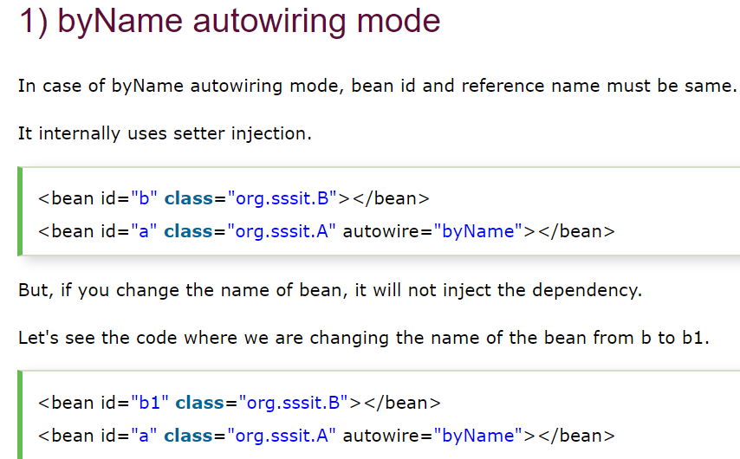
Autowire byName

Slide 52
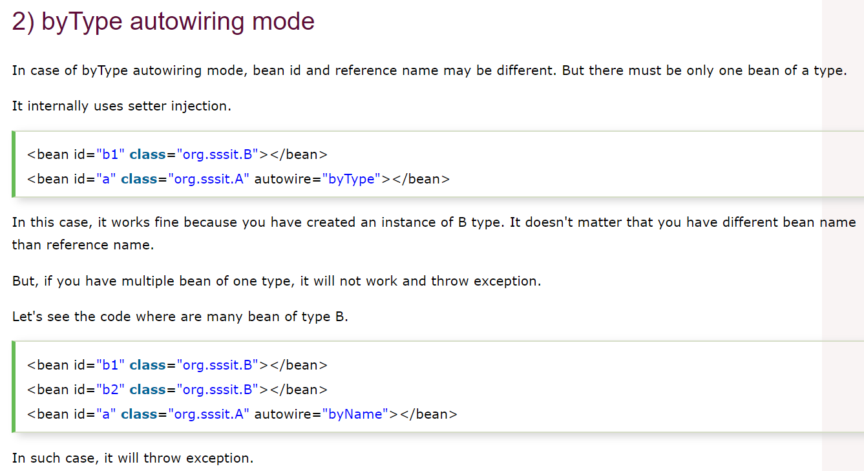
Autowire byType

Slide 53
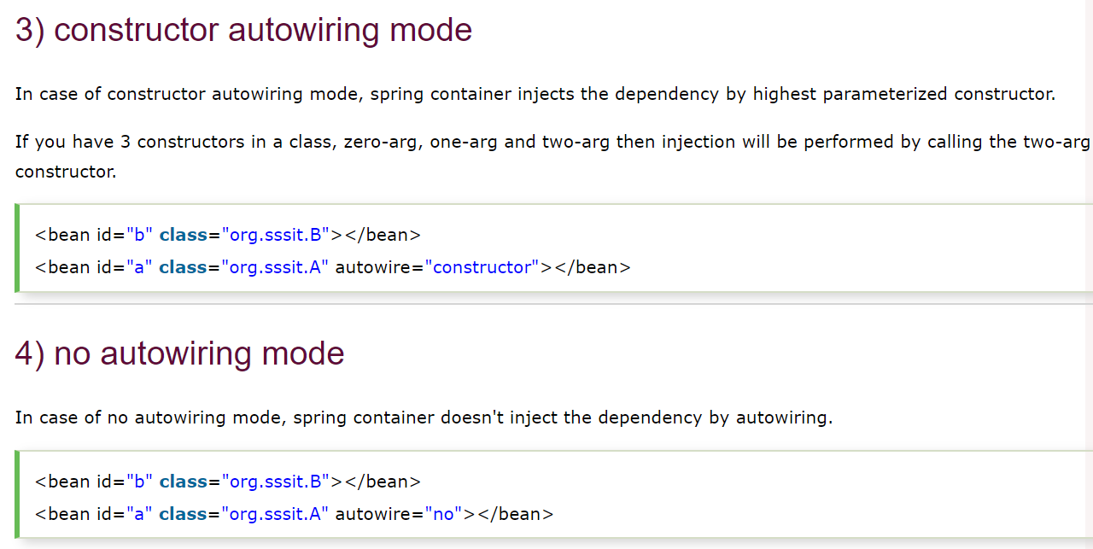
Autowire constructor & no

Slide 54
Autowiring using Annotation
Autowiring can be performed using @Autowired Annotation. An object annotated with above annotation is automatically created. By default @Autowired uses by Type.
@Qualifier annotation can be used to autowire by name, when using @Autowired annotation

Slide 55
Spring Expression Language(SpEL)
Spring introduces the Spring Expression Language (SpEL), a powerful expression language, used to wire values into bean’s properties.
Syntax to define the expression is of the form
#{ <expression string> }
Note that it may not be mandatory to use SpEL, rather it is nice to have feature.

Slide 56
We can use SpEL to inject a bean or a bean property in another bean, or even to invoke a bean method in another bean.
SpEL also supports most of the standard mathematical, logical or relational operators, as also the ternary operator (if-then-else) to perform conditional checking. We can also get the elements of a Map or a List using SpEL just like we do in Java. Regular expressions are also supported in SpEL using the matches operator. In addition, Spring provides its own API for evaluating expressions.

Slide 57
“Why use SpEL?” or “Where to use SpEL?”
The answer is to provide dynamic bean wiring (dependency injection) at runtime. In particular, you can use SpEL in conditional situations to pick the right bean or value to dependency inject based on what is happening and discovered in the application. The conditionalization could be based on the hardware platform, the operating system, application server hosting the application, the user’s locale, etc.

Slide 58
Using Spring Expression Language, we can:
Refer to other beans by id attribute
Refer to the properties and invoke methods defined in other beans
Refer to the static constants and invoke static methods
Perform Mathematical operations on values
Perform Relational and Logical comparisons
Perform Regular Expression Matching

Slide 59
Aspect Oriented Programming
One of the problems we come across source code is, using cluttered coding for some purposes such as LOgging, etc… is there anyway to overcome this. Yes, we can overcome this problem by using AOP
Aspect-Oriented Programming (AOP) complements Object-Oriented Programming (OOP) by providing one more additional way to modularize the code. As known in OOP basic unit is the class, whereas in AOP the unit is the Aspect. Aspects enable the modularization of concerns such as logging, transaction management that cut across multiple types and objects. (Such concerns are often termed crosscutting concerns in AOP literature.)
One of the key feature of Spring is the AOP framework.

Slide 60
Aspect: An aspect is a class that houses concerns that are being used across multiple classes(Business Logic). Concerns can be Logging, transactions, etc.... A class with @Aspect annotation or equivalent XML configuration is considered as Aspect.
Advice: An Aspect class can have number of member methods, which are supposed to be invoked from Business logic, automatically.
These member methods are Advices. Each Advice is provided with a PointCut expression, which indicates where this Advice need to get invoked, automatically.

Slide 61
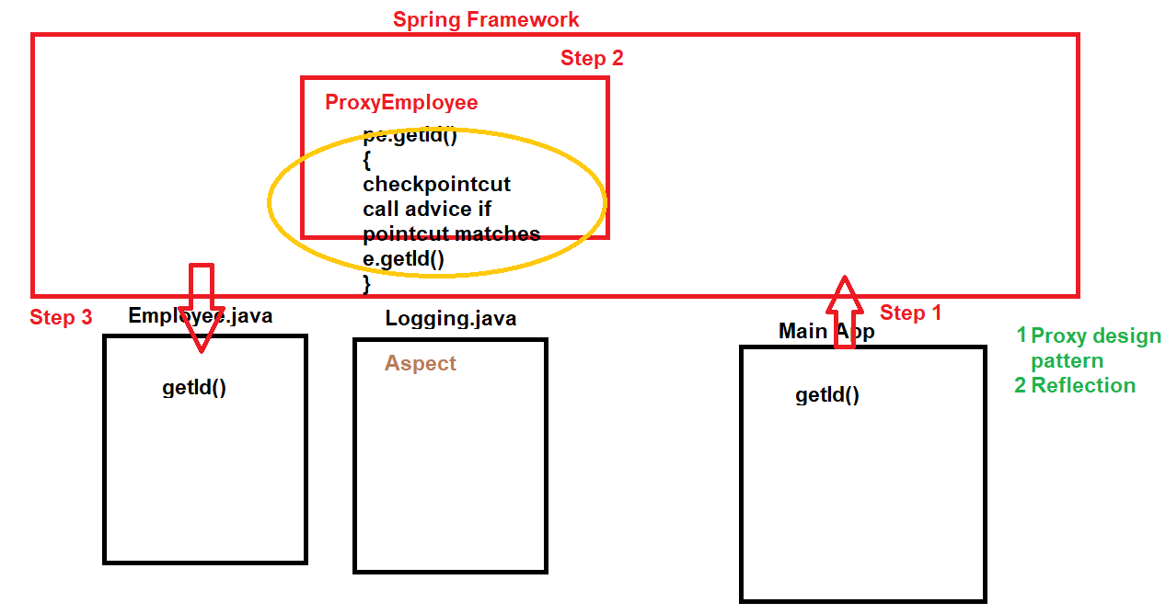
Join Point: A join point is the specific point in the application(Business Logic) from where Advice(s) gets invoked automatically, based on matching PointCut Expression.

Slide 62
Target Object: They are the object on which advices are applied. Spring AOP is implemented using runtime proxies so this object is always a proxied object. Actually, a subclass gets created at runtime where the target method is overridden and advices are included based on their configuration(Refer picture in next slide)
AOP proxy: Spring AOP implementation uses JDK dynamic proxy to create the Proxy classes with target classes and advice invocations, these are called AOP proxy classes.
Weaving: Weaving happens in run time, and it is the process of linking aspects with Target objects to create the advised proxy objects. Spring AOP performs weaving at the runtime.

Slide 63
Let us assume before Advice and after Advice is configured for a join point, below can be flow of execution.
Aspect
matching pointcut
beforeAdvice(){
//step2
}
matching pointcut
afterAdvice(){
//step5
}
Business Logic - Join Point
met1()
{
//step 1
//step3, actual business logic of Join Point
//step 4
//step6
}

Slide 64
Types of advice:
Before advice: Advice that executes before a join point, but which does not have the ability to prevent execution flow proceeding to the join point (unless it throws an exception).
After returning advice: Advice to be executed after a join point completes normally: for example, if a method returns without throwing an exception.
After throwing advice: Advice to be executed if a method exits by throwing an exception.
After (finally) advice: Advice to be executed regardless of the means by which a join point exits (normal or exceptional return).
Around advice: Advice that surrounds a join point such as a method invocation. This is the most powerful kind of advice. Around advice can perform custom behavior before and after the method invocation. It is also responsible for choosing whether to proceed to the join point or to shortcut the advised method execution by returning its own return value or throwing an exception.

Slide 65
Step 5
Class ProxyEmployee extends Employee{
Void setName(){
Invoke b4 advice
super.setName();
Invoke aft advice
}
}
Spring creates Proxy object, during run time
Spring
Step 1
Step 3
Step 4
Step 2
Main Application, which uses beans
@Aspect
Class Log
bAdvice()
aAdvice()
}
X
M
L
Business Logic
Class Employee{
Void setName(){
}
}
Aspect with Advices & PointCuts
JoinPoint

Slide 66
JoinPoint
In an Advice, it is possible to get below details of JoinPoint
1.the name of JoinPoint
2.Arguments which are passed to JoinPoint
Package: org.aspectj.lang.JoinPoint
jp.getSignature().getName()
jp.getArgs()[0]
Pointcut expressions: https://howtodoinjava.com/spring-aop/aspectj-pointcut-expressions/

Slide 67
How many Aspects we can have in an Application?
How many Before Advices, we can have in an Application?
Difference between After Advice, and After Return Advices?
What is around Advice?
Difference between After return and After throw advice?

Slide 68
Spring Designators
execution – for matching method execution join points, this is the primary pointcut designator you will use when working with Spring AOP • within – limits matching to join points within certain types (simply the execution of a method declared within a matching type when using Spring AOP) • this – limits matching to join points (the execution of methods when using Spring AOP) where the bean reference (Spring AOP proxy) is an instance of the given type • target – limits matching to join points (the execution of methods when using Spring AOP) where the target object (application object being proxied) is an instance of the given type • args – limits matching to join points (the execution of methods when using Spring AOP) where the arguments are instances of the given types
Pointcut expressions can also be combined using ‘&&’, ‘||’ and ‘!’. It is also possible to refer to pointcut expressions by name.

Slide 69
JAXB is an acronym for Java Architecture for XML Binding. It allows java developers to map Java class to XML representation. JAXB can be used to marshal java objects into XML and vice-versa. It is an OXM (Object XML Mapping) or O/M framework provided by Sun.
Hence using JAXB, we can convert an object to an equivalent XML format, and also to convert an XML back to an object.
This is required to transfer an object thru the Network, so before sending an object, it is converted to XML, then XML goes thru Network, then at receiving end, this XML is converted back to object.
Marshalling and Unmarshalling.
Mapping XML to Object is called unmarshalling and mapping an object to XML is called Marshalling.
Why to use OXM frameworks with Spring?
XML using Spring is supported by Spring’s OXM module. Spring provides an extensible , easy and simple way to use various O/X framework. By using Spring provided interfaces, one can switch between different O/X framework by a simple change in configuration, and may not need source code changes.

Slide 70
There are other third party OXM Frameworks like,
Xstream, jibx

Slide 71
There are other third party OXM Frameworks like,
Xstream, jibx

Slide 72
Spring JDBC & ORM(Hibernate)

Slide 73
Spring JDBC Template
Problems with Traditional JDBC API
Number of steps and lines of code written is more.
Steps like loading driver, connecting, creating statement, etc.. Need to be done every time.
Code is not organized.
Advantages of Spring JDBC Template
Number of lines of code is less
DB details are configured with XML, hence can be changed without re building the project
Code is better organized, hence has better readability and maintainability.
Mapping between related objects is not taken care unlike Hibernate.

Slide 74
Spring JDBC Template
Java Application
Spring JDBC Template(jar file)
JDBC Driver(jar file)
Database Server
(MySQL, Oracle,etc…)

Slide 75
Spring JDBC Template
Below are Spring classes/interface which need to be used for Spring JDBC Template
JdbcTemplate is used, for the same. JdbcTemplate is part of Spring Framework.
DriverManagerDataSource is a built in class, to which we need to inject data base details like JDBC Driver, db name/password, etc… thru Spring XML Config file.
RowMapper is a built in interface, which need to be implemented by a class, to provide mapping between each table column and data member of the Class

Slide 76
Spring Hibernate Template
As known below steps need to be performed, when a program uses traditional Hibernate Framework.
Creating session factory
Open Session
Begin Transaction
Commit or Rollback Transaction
Close Session
Advantage of using Hibernate, along with Spring is, reduction of code size. It is not required to perform below steps, for every interaction with Hibernate Framework.
And it is not mandatory to handle SQL/DB related Exceptions.

Slide 77
Spring Hibernate Template
Java Application
Spring HibernateTemplate(jar file)
Hibernate(jar file)
JDBC Driver(jar file)
Database Server
(MySQL, Oracle,etc…)

Slide 78
Spring Hibernate Template
Below are classes of spring, that need to be used
HibernateTemplate – provides methods to save, delete objects of Persistent class
DriverManagerDataSource – used in XML file, to specify db url, and db username and pwd.
LocalSessionFactoryBean – used in XML file, used in creation of SessionFactory

Slide 79
Spring MVC
@RequestParam and @PathVariable annotations are used for accessing the values from the request. Both the the annotations have the significant purpose and use respectively. The key difference between @RequestParam and @PathVariable is that @RequestParam used for accessing the values of the query parameters where as @PathVariable used for accessing the values from the URI template.
@RequestParam
@RequestParam annotation used for accessing the query parameter values from the request. Look at the following request URL:
http://localhost:8080/springmvc/hello/101?param1=10¶m2=20 In the above URL request, the values for param1 and param2 can be accessed as below:
public String getDetails( @RequestParam(value="param1", required=true) String param1, @RequestParam(value="param2", required=false) String param2){ ... }

Slide 80
Spring MVC
Fully integrates with the Spring dependency injection framework
Used to handle all incoming requests and route them through Spring
Spring MVC provides an elegant solution to use MVC in spring framework by the help of DispatcherServlet.
In Spring Web MVC, DispatcherServlet class works as the front controller. It is responsible to manage the flow of the spring mvc application.
The @Controller annotation is used to mark the class as the controller in Spring .
The @RequestMapping annotation is used to map the request url. It is applied on the method.

Slide 81
Spring MVC, What is a Model?
A Model is used in Spring MVC to pass objects from the controller tier up into the view
A Model is really just a java.util.Map
You can add attributes to a Model and they will be put on the request as attributes and will make them available in the applications PageContext .

Slide 82
Spring Batch Processing
Spring Batch is a framework from the Spring family that makes processing of batch jobs easier, modular and scalable.
Typical Batch processing programs to processes billions of transactions every day for large enterprises. These can be consolidation of month end sales, correction of errors, price and loyalty corrections, rate adjustments, insurance benefit determinations and so on.
How Spring helps us to write Batch Programs?
Spring batch is a robust framework for such batch processing needs. It provides developers with design patterns and framework code that solves common batch problems and allows developers to focus more on the business requirements and less on complex batch infrastructure.
Spring provides APIs to read/write resources, transaction management, restart failed jobs, monitor jobs and techniques like multi threading and partitioning.
In short, it provides solutions to almost all problems faced in the processing of complex batch operations.

Slide 83
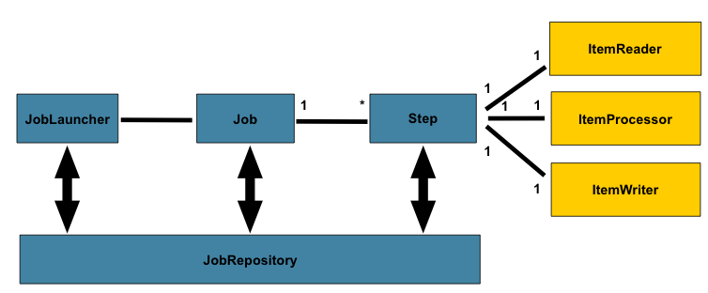
Below are classes provided by Spring batch

Slide 84
Spring Batch Processing
Spring Batch is a lightweight, Open Source batch processing framework designed to handle the day-to-day batch processing jobs involving bulk of data.
JobLauncher Starts a job execution for the given Job and JobParameters . If a JobExecution was able to be created successfully, it will always be returned by this method, regardless of whether or not the execution was successful.
A Job is composed of one to many Steps. Each Step can work in two modes :
#1. Chunk Oriented Processing or READ-PROCESS-WRITE mode: Step needs to read from a resource , process the data and then write back the process data to a resource. In this approach, Step has exactly oneItemReader(reader which reads from a resource, be it file, database, messaging queue etc.),ItemProcessor ( provides a hook to apply business logic) and ItemWriter (writer which writes to a resource, be it file, database, messaging queue etc). Once the number of items read equals the commit interval, the entire chunk is written out via the ItemWriter, and then the transaction is committed.
#2. TASKLET mode: Step has to perform a single operation (be it just sending email, executing a stored procedure, cleaning up files older than x days, etc). In this approach Step includes a Tasklet interface which have only one method execute which can perform above mentioned activities. A job is launched via JobLauncher, and JobRepository stores the meta data about the currently running process.Note that Steps can be chained together.
Skippable Exceptions are used to skip elements during reading, processing and writing and continue to the next element.

Slide 85
Spring Remoting
Spring includes a support for integrating with various Remoting technologies such as RMI.
Remote services are services hosted on remote servers and accessed by clients over the network. For example, lets say you are developing a desktop application that needs to connect to a central server.
Advantages of using Spring with RMI
You don’t need to extend any RMI related Interfaces.
So you can concentrate your application business logic rather than RMI specific codes.
When you don’t extend RMI related Interfaces your application can export any other services without changing your existing code.
Also you can write web client or any other service without changing existing code.
This will improve your system Flexibility, Maintainability, and Extensibility.
Hence, by using spring, RMI specific codes move into xml file. This reduces complexity of codes. Hiding complexity is another advantage.

Slide 86
New features in Spring 4.x
Spring Framework 4.0 provides support for several Java 8 features.
Support WebSocket, SockJS, and STOMP Messaging
Core Container improvements: Auotwiring supported for generics
Deployment to Servlet 2.5 servers remains an option, but Spring Framework 4.0 is now focused primarily on Servlet 3.0 environments.

Slide 87
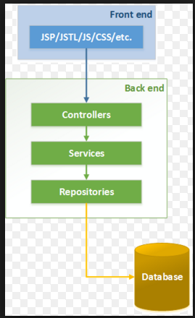
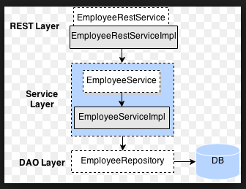

Slide 88
Spring MVC Binding URL Query Parameters
@RequestParam annotation is used to bind parameter values in query string to controller method parameters.
Parameter name in url and method parameter name are different
@RequestParam("dept") String deptName
Parameter name in url and method parameter name are same
@RequestParam String state
Multiple @RequestParam annotations can be used, to receive multiple parameters
/employees?dept=IT&state=NC
@RequestParam("dept") String deptName, @RequestParam("state") String stateCode
Using Map with @RequestParam for multiple params
Map is populated with all parameter names and values in the url
@RequestParam Map<String, String> queryMap
Auto type conversion If target method parameter is not String, automatic type conversion can happen. All simple types such as int, long, Date, etc. are supported by default. Following will map to /employees/234/paystubs?months=5
@RequestParam("months") int previousMonths

Slide 89
Spring MVC Binding URL Query Parameters
'required' element of @RequestParam
This element defines whether the parameter is required. The default is true. That means the status code 400 will be returned if the parameter is missing in the request. We can switch this to false if we prefer a null value if the parameter is not present in the request.
@RequestParam(value = "project", required = false) String projectName
'defaultValue' element of @RequestParam
defaultValue is being used when the parameter is missing or is empty in the url
@RequestParam(value = "project", defaultValue="kara") String projectName

Slide 90
Spring Security
Spring Security is a customizable authentication and access service framework for server side Java-based enterprise software applications
Spring security OAuth provides a method for making authenticated HTTP requests using a token - an identifier used to denote an access grant with specific scope, duration, and other attributes.
Tokens are issued to third-party clients by an authorization server with the approval of the resource owner. Instead of sharing their credentials with the client, resource owners grant access by authenticating directly with the authorization server which in turn issues a token to the client.
The client uses the token (and optional secret) to authenticate with the resource server and gain access.
"Authentication" is the assurance that the user is actually the user he is claiming to be, for example, when the user logs into any application and gives his credentials, he authenticates himself. At the authentication level, spring supports various authentication models such as Http Basic authentication, Form Based authentication.

Slide 91
Spring Security
"Authorization" is the assurance that the user is allowed to access only those resources that he is authorized to use. For example, in a corporate application, there are some parts of an application where only admin have access and to some parts all the employees have access. These access rules are determined by the access rights given to each user of the system. At the authorization level, spring targets three main areas: authorizing web request, authorizing whether methods can be invoked and authorizing access to individual domain object instances.

Slide 92
Spring Security "Authorization" is the assurance that the user is allowed to access only those resources that he is authorized to use. For example, in a corporate application, there are some parts of an application where only admin have access and to some parts all the employees have access. These access rules are determined by the access rights given to each user of the system. At the authorization level, spring targets three main areas: authorizing web request, authorizing whether methods can be invoked and authorizing access to individual domain object instances.

Slide 93
Spring WebServices

Slide 94
Spring Web Services

Slide 95
Thank You

